Slide 1
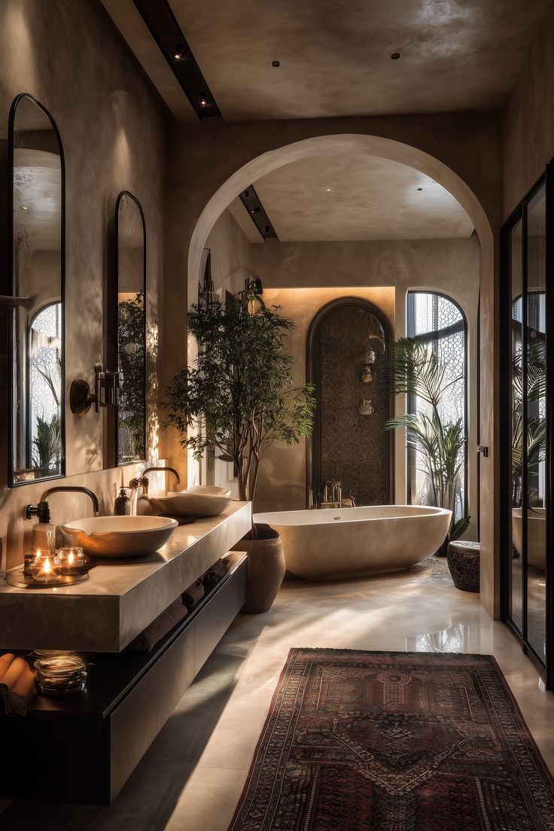
OFFICIAL BRAND DECK
2 0 2 6
RITUAL
&
STONE
S T U D I O

Slide 2

RITUAL & STONE STUDIO
2 0 2 6
INTRODUCTION
Ritual & Stone Studio is a remote-first luxury bathroom design consultancy based in Australia.
We help homeowners and renovators define their design vision before the build begins — so every tile, every fitting, every finish is chosen with intention.

Slide 3
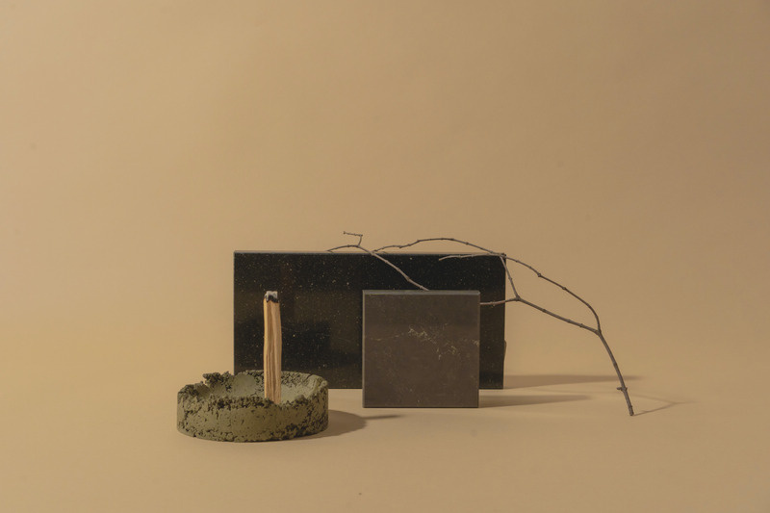
RITUAL & STONE STUDIO
2 0 2 6
Table Of Contents
About Us
01
Our Services
02
Our Story
03
How We Work
04
Contact Us
05
A remote-first consultancy for homeowners
who want clarity before their renovation begins.

Slide 4

RITUAL & STONE STUDIO
2 0 2 6
01 About Us
We believe that a beautifully designed bathroom is not a luxury — it is a necessity.
We exist to close the gap between what renovators imagine and what actually gets built, by guiding every design decision before a tradesperson arrives.
Founded by Ced Karmela Fabillar, a former Porcelanosa consultant with deep knowledge of luxury materials and European design standards, Ritual & Stone Studio brings that same level of expert guidance directly to Australian homeowners.
Our services are entirely remote — delivered through video consultations, curated mood boards, and detailed specification guides that serve as your blueprint for every conversation with a builder or supplier.
Whether you are redesigning a single ensuite or building a sanctuary from the ground up, we bring Porcelanosa-level precision to every project.
We work with clients across Australia who want intentional, beautiful spaces — and who understand that the most important decisions happen long before the first tile is laid.

Slide 5
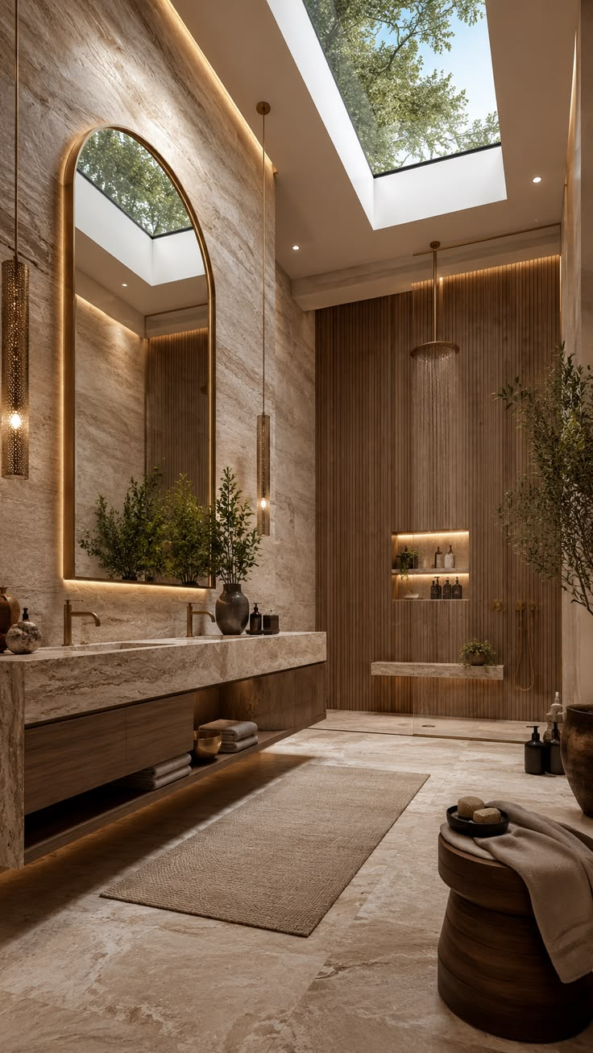
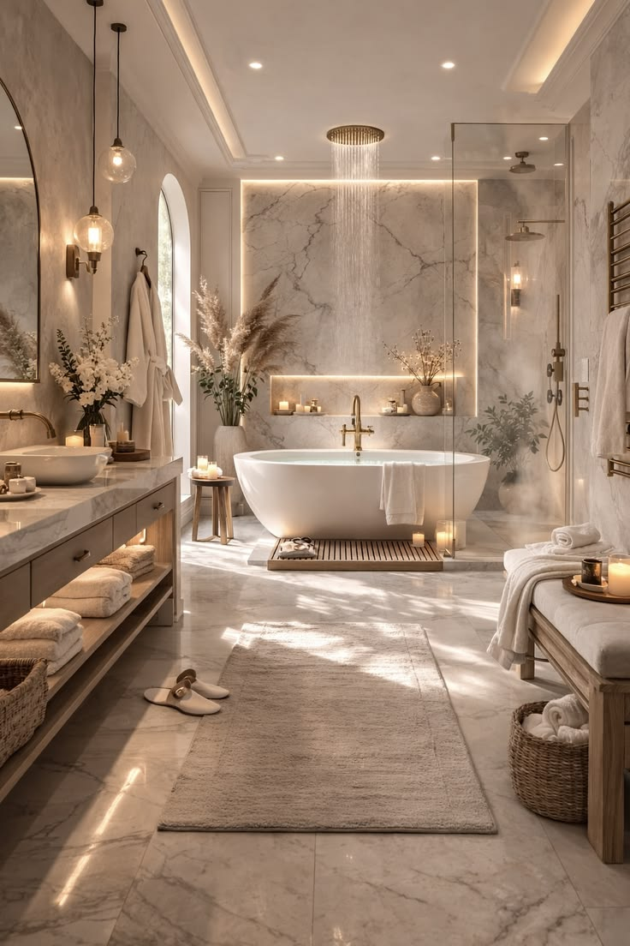
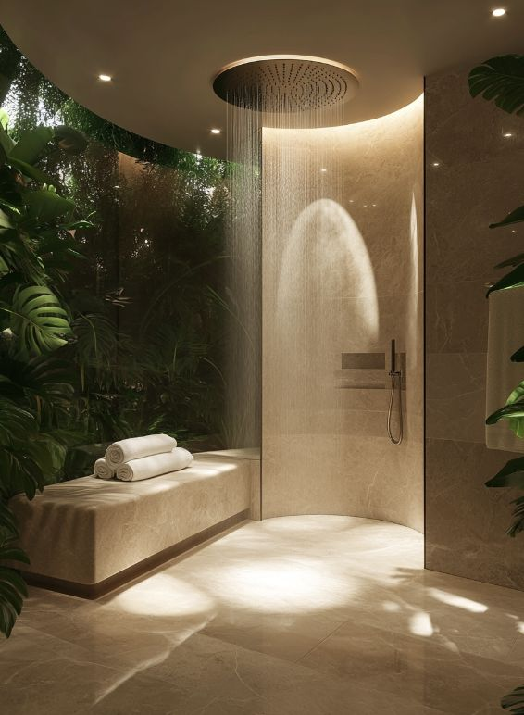
RITUAL & STONE STUDIO
2 0 2 6
02 Our Services
Design Discovery
Consultation
A 90-minute video consultation mapping your space, lifestyle, and renovation timeline. The foundation for every decision that follows.
Mood Board &
Vision Package
A curated visual direction document capturing your design identity — the north star for every material and finish choice.
Materials &
Specification Guide
Room-by-room surface specifications with exact product, finish, and supplier recommendations your builder can action directly.
Digital Concept
Rendering
See your completed space before a single tile is ordered. Full visualisation so nothing is left to imagination.

Slide 6
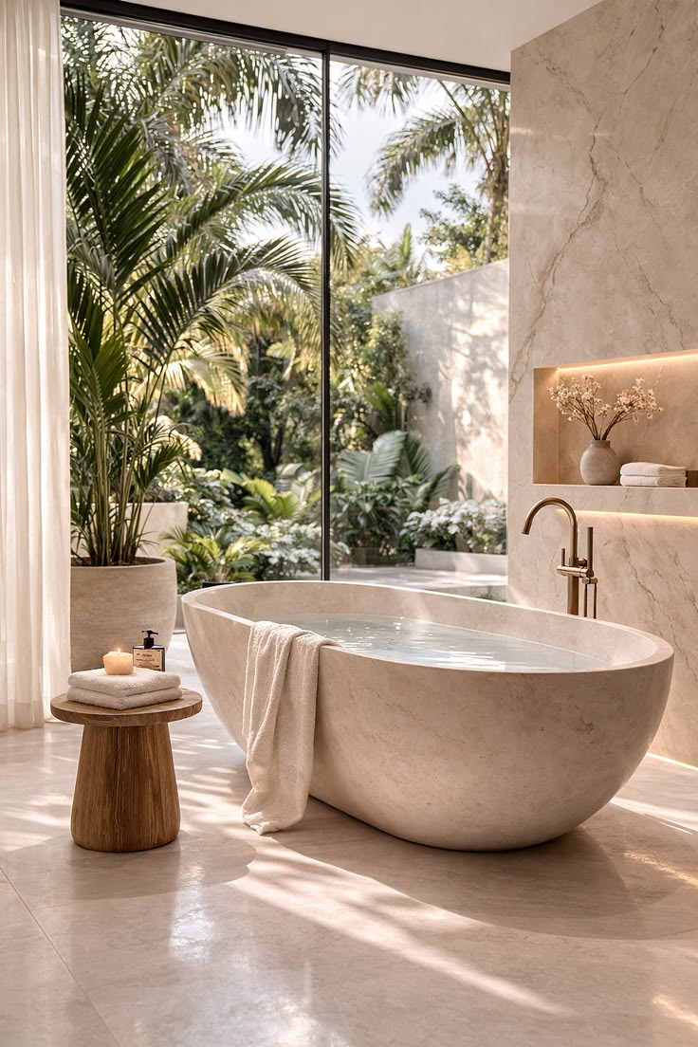
RITUAL & STONE STUDIO
2 0 2 6
“Your bathroom is one of the most used rooms in your home.
It should feel like a sanctuary — not an afterthought.”
— Ced Karmela Fabillar, Founder · Ritual & Stone Studio

Slide 7
RITUAL & STONE STUDIO
2 0 2 6
03 Our Story
2024
2025
Ritual & Stone Studio founded by Ced Karmela Fabillar, drawing on years of expertise at Porcelanosa and in luxury materials.
Business registered with ASIC. Brand identity developed. Design process framework built and tested.
2026
2026 →
Official launch. Remote consultation services open to clients across Australia.
First design packages delivered. Building a portfolio of sanctuaries, one bathroom at a time.

Slide 8
RITUAL & STONE STUDIO
2 0 2 6
04 How We Work
Discover
Vision
Initial 90-min video
consultation to understand
your space and timeline.
Curated mood board
and design direction
capturing your look and feel.
A structured five-step process built around your renovation timeline.

Slide 9
RITUAL & STONE STUDIO
2 0 2 6
Discover
Vision
Specify
Present
Support
Initial consultation
to understand your
space and timeline
Curated mood board
capturing your design
look and feel
Room-by-room materials
guide with product
recommendations
Concept rendering
and full specification
handover package
On-call guidance
during procurement
and builder briefings

Slide 10
RITUAL & STONE STUDIO
2 0 2 6
05 Contact Us
Whether you are redesigning a single ensuite or building your dream bathroom from the ground up, we would love to hear from you.
Ritual & Stone Studio works remotely with clients across Australia, delivering luxury design guidance that sets your renovation up for success — before a single tradesperson arrives.
Email
Instagram
hello@ritualandstonestudio.com
@ritualandstonestudio
Pinterest
Web
@ritualandstonestudio
ritualandstonestudio.com
Instagram · Pinterest · Email
@ritualandstonestudio

